Slide 1
Build the best
24 мая 2013
КРОС2013
Kosinov Dmitry
Notes:
Thank you for taking time to learn more about Mykonos solution from Juniper Networks. Mykonos is the the first and only “intrusion deception” system in the marketplace.
I’m going to spend 20 minutes helping you understand how Mykonos thinks about and manages hackers and web security.
Before we get started I would like to better understand what prompted your interest in Mykonos and how your organization thinks about and manages hackers. It would very helpful to me if you could describe the types of attacks that concern you and the web app security products you use to defend against those attacks. And finally, any guidance you can provide me about your timeline for taking action to better secure your web apps would help me better support you.
(Thank you for sharing – that was very helpful.)
Let me provide you with some background on Mykonos.
Mykonos was spun-off from BlueTie, a large SaaS provider that utilized a variety of off-the-shelf and custom web apps to process terabytes of information for millions of users.
So, naturally, the web apps had vulnerabilities. And hackers exploited those vulnerabilities causing much damage. So we responded. We went out into the marketplace and found the same two products – code scanning and WAFs – that are available to every other organization.
Now, the challenges and problems with code scanning are very clear: scanning code for vulnerabilities yields thousands of lines of data with a false positive rate that can approach 50%. Employing an army of analysts to sift through that data and make sense of it is not practical. And when you discover an off-the-shelf vulnerability, perhaps in Share Point, how do you fix it? You are at the mercy of the vendor. You can’t exactly ring up Microsoft and ask them to fix it. Code scanning does not provide real time security.
The other option is a WAF. Ironically, WAFs are not firewalls. Think about a network firewall – it’s a positive security model (white list) which means it blocks ALL traffic except for a known set of friendly traffic. A WAF is the exact opposite of a network firewall. It is a negative security model (black list) which means it allows ALL traffic except for a known set of bad traffic – or what is commonly referred to a library of attack signatures.
WAFs rely exclusively on the failed anti-virus approach. Every year antivirus amasses a bigger library of signatures, and every year anti-virus fails to solve the malware problem. In fact, today, I can purchase a single custom virus that won’t match any existing AV signature.” It’s worth mentioning that the average AV program has 40 million signatures. Do we really believe the 41st millionth signature will solve the problem? We don’t. So, the very product (WAF) that has defined web security for the last 7 or 8 years isn’t even what it claims to be.
More to the point, a finite library of attack signatures can stop and infinite number of attacks.
Additionally, we learned that it is very difficult to deploy WAFs in block mode. The reason: signatures. For example, if you write a rigid signature it blocks too much traffic, yielding false positives. If you write a flimsy signature it allows too much traffic, creating vulnerabilities. So what are you left with? A WAF that can’t run in block mode is nothing more than a fancy log file - or an IDS – that gives you a picture of your business after it burned down. What we wanted - and what every organization needs - is a smoke alarm that detects suspicious or malicious activity without false positives before that activity materializes into an attack. Mykonos is not only your smoke alarm – it is you fire engine too!

Slide 2
Junos equipment Update
Notes:
Thank you for taking time to learn more about Mykonos solution from Juniper Networks. Mykonos is the the first and only “intrusion deception” system in the marketplace.
I’m going to spend 20 minutes helping you understand how Mykonos thinks about and manages hackers and web security.
Before we get started I would like to better understand what prompted your interest in Mykonos and how your organization thinks about and manages hackers. It would very helpful to me if you could describe the types of attacks that concern you and the web app security products you use to defend against those attacks. And finally, any guidance you can provide me about your timeline for taking action to better secure your web apps would help me better support you.
(Thank you for sharing – that was very helpful.)
Let me provide you with some background on Mykonos.
Mykonos was spun-off from BlueTie, a large SaaS provider that utilized a variety of off-the-shelf and custom web apps to process terabytes of information for millions of users.
So, naturally, the web apps had vulnerabilities. And hackers exploited those vulnerabilities causing much damage. So we responded. We went out into the marketplace and found the same two products – code scanning and WAFs – that are available to every other organization.
Now, the challenges and problems with code scanning are very clear: scanning code for vulnerabilities yields thousands of lines of data with a false positive rate that can approach 50%. Employing an army of analysts to sift through that data and make sense of it is not practical. And when you discover an off-the-shelf vulnerability, perhaps in Share Point, how do you fix it? You are at the mercy of the vendor. You can’t exactly ring up Microsoft and ask them to fix it. Code scanning does not provide real time security.
The other option is a WAF. Ironically, WAFs are not firewalls. Think about a network firewall – it’s a positive security model (white list) which means it blocks ALL traffic except for a known set of friendly traffic. A WAF is the exact opposite of a network firewall. It is a negative security model (black list) which means it allows ALL traffic except for a known set of bad traffic – or what is commonly referred to a library of attack signatures.
WAFs rely exclusively on the failed anti-virus approach. Every year antivirus amasses a bigger library of signatures, and every year anti-virus fails to solve the malware problem. In fact, today, I can purchase a single custom virus that won’t match any existing AV signature.” It’s worth mentioning that the average AV program has 40 million signatures. Do we really believe the 41st millionth signature will solve the problem? We don’t. So, the very product (WAF) that has defined web security for the last 7 or 8 years isn’t even what it claims to be.
More to the point, a finite library of attack signatures can stop and infinite number of attacks.
Additionally, we learned that it is very difficult to deploy WAFs in block mode. The reason: signatures. For example, if you write a rigid signature it blocks too much traffic, yielding false positives. If you write a flimsy signature it allows too much traffic, creating vulnerabilities. So what are you left with? A WAF that can’t run in block mode is nothing more than a fancy log file - or an IDS – that gives you a picture of your business after it burned down. What we wanted - and what every organization needs - is a smoke alarm that detects suspicious or malicious activity without false positives before that activity materializes into an attack. Mykonos is not only your smoke alarm – it is you fire engine too!

Slide 3
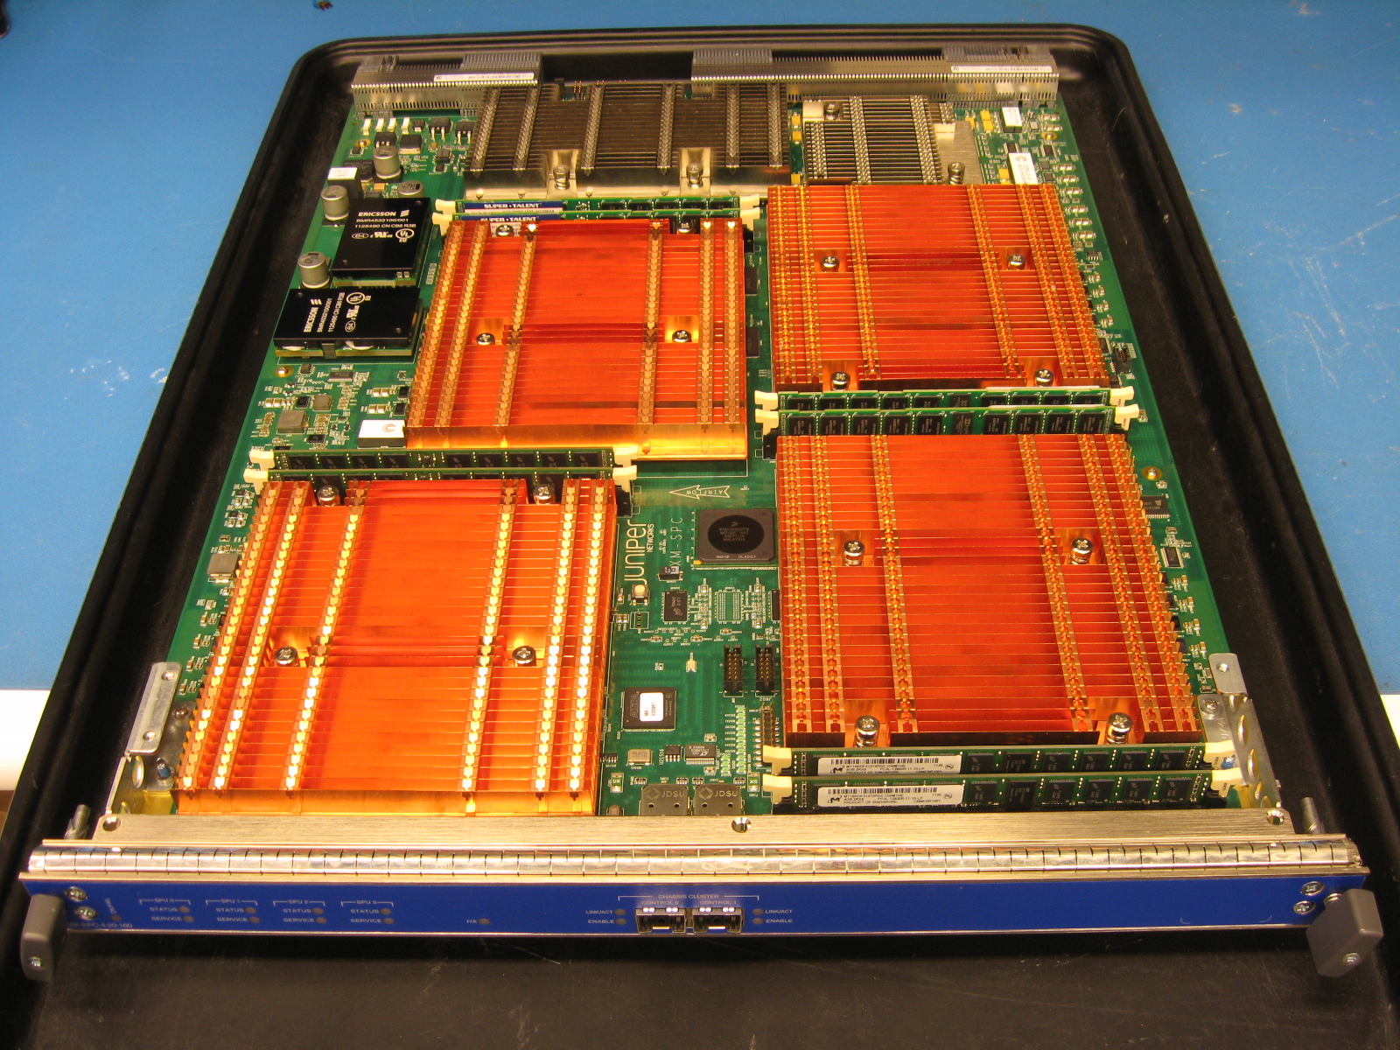
Next Generation SPC
SPUs
  Four v Two
  Higher Clock-Speed
Processor
    Broadcom
      XLP
Memory
    32G/SPU
Performance
  Более энергоэффективен
  Больше IPSEC
Notes:
Next Generation SPC
The first feature that we’re releasing is the next generation SPC card. So in terms of SPUs, it has four against two in the current model. The clock speed is higher when compared to the current generation card. The processor is changing to a Broadcom-XLP model. The memory available is 32G per SPU. And in terms of performance, there’s less power consumption and it also gives more cryptographic throughput.

Slide 4
SRX5K Current SPC v NG-SPC
 | CG-SPC | NG-SPC
Lightweight Svcs Max Throughput (FW, NAT) | 20G | 35G
Max pps | 2Mpps | 6Mpps
Sessions (v4/v6) | 2M | 4M (16m – maximize sessions mode, impacts performance)
Max cps | 100K | 240K
Max IPSEC throughput | 5G | 20G
IPS throughput | 3G | 10G
Max ALG | 10K | 25K
System max Policy | 80K | 80K
Max FIB | 500K | 500K
Notes:
SRX5K Current SPC v NG-SPC
This slide shows the capabilities of the current SPC card against the next generation SPC card. As you can see, there’s a significant uplift in terms of performance for services and raw packets per second through the card. Specifically, from a VPN perspective, then we can go from a maximum capability of around 5Gbps to 20Gbps. There is an increase in the list price due to the increased hardware on the card. But because the performance increases are significantly more than next generation solutions, it should be more cost effective when priced for the customer.

Slide 5

Gi FW/NAT: Sample BOM SRX 5k
HW TYPE | 20G imix/20M FW/NAT | 50G imix/ 40M FW/NAT | Incremental cost per 10M sessions | Incremental cost per 10G IMIX
CG-SPC/IOC | $1.168m 10 x SPC + 1 x IOC + 1 x 5800 Base Chassis | $2.536m 20 x SPC + 4 x IOC + 2 x 5800 Base Chassis | $500k Assuming no new chassis & IOC is needed | $200k Assuming no new chassis &/or IOC is needed
NG-SPC/IOC | $368k 2 x NG-SPC + 1 x IOC + 1 x 5800 Base Chassis | $668k 4 x NG-SPC + 2 x IOC + 1 x 5800 Base Chassis | $100k Assuming no new chassis & IOC is needed | $100k Assuming no new chassis &/or IOC is needed
Savings with NG-SPC | 68% | 73% | 80% | 50%

Slide 6
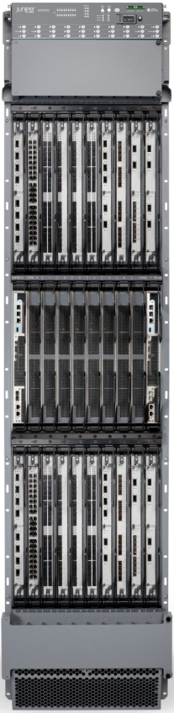
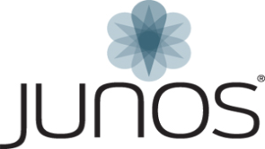
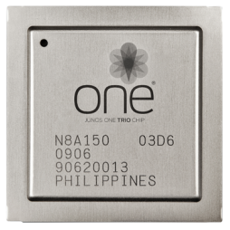
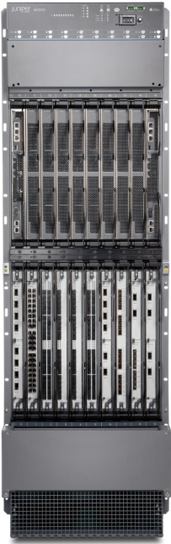
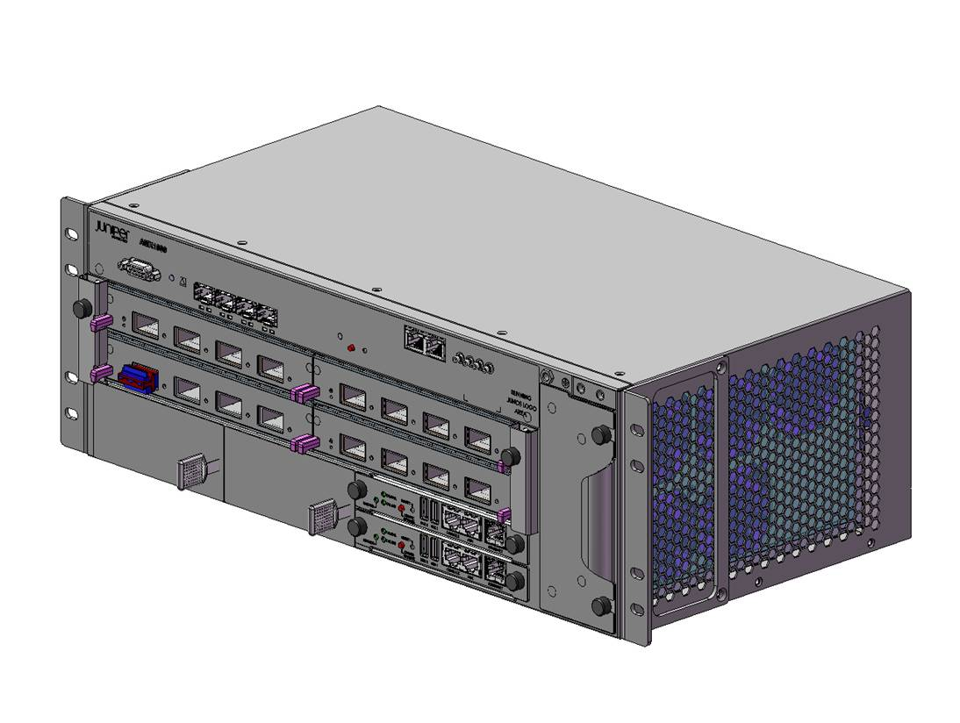
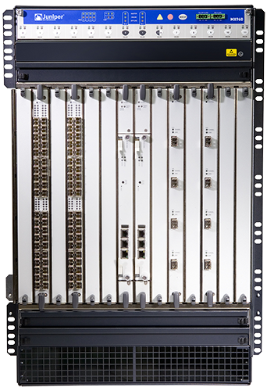
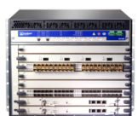
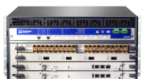
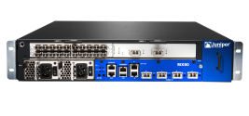

Introducing MX104 – MOST COMPACT MX!
80Tbps
34Tbps
One JUNOS
One TRIO CHIPSET
One UNIVERSAL EDGE
40Tbps
17Tbps
8.8Tbps
5.3Tbps
2.6Tbps
80Gbps
4.8Tbps
2.8Tbps
1.4Tbps
1.6Tbps
MX104
20Gbps
40Gbps
60Gbps
80Gbps
MX 5
MX 10
MX 40
MX 80
∧
MX 240
MX 480
MX 960
MX 2010
MX 2020
REVENUE GENERATION FOR THE NEXT DECADE
Notes:
The newest additions to the Universal Edge Family.
The 40Tbps MX 2010 , and the 80Tbps MX2020.
One Junos OS…One trio Chipset…one family of powerful, open, service rich platforms covering a breadth of applications from 20Gbps all the way up to 80Tbps.

Slide 7
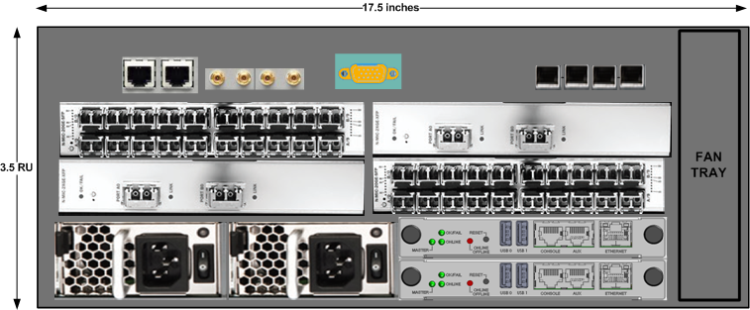
MX104
13.2R1
Compact, Redundant & Future proof
    Trio based PFE – 80G
  7.5 inches (W) x 3.5RU (H) x 9.5 inches (D)
  ETSI-300 compliant
  Dual redundant hot-pluggable REs for Control Plane redundancy
  Dual redundant 1RU 600 Watt PSUs; AC and DC inputs variants
  Wide operating temp range -40C to +65C
  Forced cooling with side-to-side airflow; FRU’able fan tray
  Alarm extension ports
Modular Design:
4x10GE SFP+ LAN/WAN uplink ports (built-in)
4 MIC Slots -~20G BW per slot
Timing:
BITS (T1/E1), 10MHz &1PPS and ToD timing IO interfaces
Sync E, SONET and 1588 (Brilliant IP integration) timing features

Slide 8
Service MIC and NEXT-GEN SERVICE MPC
Service MPC Design - 4 NPUs
L4-7 Services, IPSEC, Stateful Firewall, NAT
  Very high scale/feature performance for NG Mobility
  Up to 48Gbps of services capacity
NG NPU
Switch Fabric
NG NPU
TRIO
NG NPU
NG NPU
Service MIC Design - One NPU per MIC
L4-7 Services ,IPSEC, Stateful Firewall, NAT
  For MX deployments needing to optimize slot real-estate and MX80
  Up to 9 Gbps of services capacity
Service
MIC
NG NPU
MPC/MX80
2T 2013

Slide 9
Hardware Platform Roadmap
Software schedule is on the following slides
2T2013
  MX 960, MX480, MX240, MX80, MX40, MX20, MX5
  MX2020/1010
    MS-MIC only
      JFLOW only
  MPC support
    1, 2 and 3
3T2013
  MX2020/1010
    MS-MIC only
      All services (see supporting slides)
2T2014
  MX2020/1010
    MS-MPC all services

Slide 10
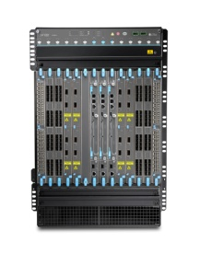
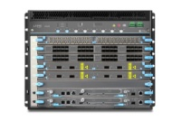
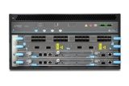

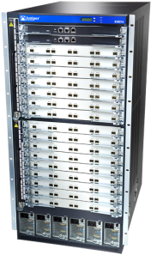

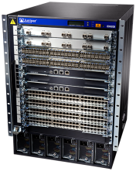

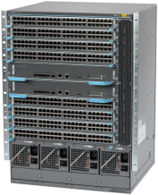

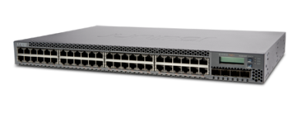


Juniper коммутаторы
40 / 100 GbE
Core
EX9200
10GbE
QFX3600
QFX3500
EX8200
Performance
EX4550
EX4500
Access
EX4200
EX6200
EX3300
Programmability
EX2200
Modular
EX2200-C
Hardware Resiliency
Ports
Virtual Chassis
QFabric

Slide 11
Junos DDOS Secure
Notes:
Thank you for taking time to learn more about Mykonos solution from Juniper Networks. Mykonos is the the first and only “intrusion deception” system in the marketplace.
I’m going to spend 20 minutes helping you understand how Mykonos thinks about and manages hackers and web security.
Before we get started I would like to better understand what prompted your interest in Mykonos and how your organization thinks about and manages hackers. It would very helpful to me if you could describe the types of attacks that concern you and the web app security products you use to defend against those attacks. And finally, any guidance you can provide me about your timeline for taking action to better secure your web apps would help me better support you.
(Thank you for sharing – that was very helpful.)
Let me provide you with some background on Mykonos.
Mykonos was spun-off from BlueTie, a large SaaS provider that utilized a variety of off-the-shelf and custom web apps to process terabytes of information for millions of users.
So, naturally, the web apps had vulnerabilities. And hackers exploited those vulnerabilities causing much damage. So we responded. We went out into the marketplace and found the same two products – code scanning and WAFs – that are available to every other organization.
Now, the challenges and problems with code scanning are very clear: scanning code for vulnerabilities yields thousands of lines of data with a false positive rate that can approach 50%. Employing an army of analysts to sift through that data and make sense of it is not practical. And when you discover an off-the-shelf vulnerability, perhaps in Share Point, how do you fix it? You are at the mercy of the vendor. You can’t exactly ring up Microsoft and ask them to fix it. Code scanning does not provide real time security.
The other option is a WAF. Ironically, WAFs are not firewalls. Think about a network firewall – it’s a positive security model (white list) which means it blocks ALL traffic except for a known set of friendly traffic. A WAF is the exact opposite of a network firewall. It is a negative security model (black list) which means it allows ALL traffic except for a known set of bad traffic – or what is commonly referred to a library of attack signatures.
WAFs rely exclusively on the failed anti-virus approach. Every year antivirus amasses a bigger library of signatures, and every year anti-virus fails to solve the malware problem. In fact, today, I can purchase a single custom virus that won’t match any existing AV signature.” It’s worth mentioning that the average AV program has 40 million signatures. Do we really believe the 41st millionth signature will solve the problem? We don’t. So, the very product (WAF) that has defined web security for the last 7 or 8 years isn’t even what it claims to be.
More to the point, a finite library of attack signatures can stop and infinite number of attacks.
Additionally, we learned that it is very difficult to deploy WAFs in block mode. The reason: signatures. For example, if you write a rigid signature it blocks too much traffic, yielding false positives. If you write a flimsy signature it allows too much traffic, creating vulnerabilities. So what are you left with? A WAF that can’t run in block mode is nothing more than a fancy log file - or an IDS – that gives you a picture of your business after it burned down. What we wanted - and what every organization needs - is a smoke alarm that detects suspicious or malicious activity without false positives before that activity materializes into an attack. Mykonos is not only your smoke alarm – it is you fire engine too!

Slide 12
JUNOS DDoS SECURE
Пакеты проходят проверку RFC фильтры
Деформированные пакеты и пакет пришедшие вне очереди - отбрасываются
Каждому адресу назначается значение CHARM
Значения назначаются на основе статистики поведения IP адреса
Mechanistic
Traffic
Low
CHARM Value
First Time
Traffic
Medium
CHARM Value
Humanistic,
Trusted Traffic
High
CHARM Value

Slide 13
Эвристическое предотвращение атаки
Normal Internet Traffic
Normal Internet Traffic
DDoS Attack Traffic
Resources
Normal Internet Traffic
Junos DDoS Secure Heurisitc Analysis
DDoS Attack Traffic
Management PC
Обычный интернет трафик проходит через устройствл DDoS secure в это время анализируется тип, происхождение , потоки, скорость, согласование и протоколы используемые входящим и исходящим трафиком. Анализ является эвристическим и со временем перенастраивается , но применяется в режиме real-time с минимальными задержками

Slide 14
JUNOS DDoS SECURE
Варианты использования
Juniper Hardware and Virtual Appliance Options
Standalone
Fail-safe Cards
Active – Standby
Active – Active (Asymmetric Routing)

Slide 15
JUNOS DDoS SECURE
Поддержка 24/7
80% эффективность
сразу после инсталяции
99.999% эффективность после 6-12 ч
Виртуализация решения
Динамическая эвристическая технология
Прокси-сервис
10GB+
устройства
Не используют IP
Layer 2
прозрачная обработка трафика

Slide 16
JunosV FireFly
Виртуальный межсетевой экран
Notes:
Thank you for taking time to learn more about Mykonos solution from Juniper Networks. Mykonos is the the first and only “intrusion deception” system in the marketplace.
I’m going to spend 20 minutes helping you understand how Mykonos thinks about and manages hackers and web security.
Before we get started I would like to better understand what prompted your interest in Mykonos and how your organization thinks about and manages hackers. It would very helpful to me if you could describe the types of attacks that concern you and the web app security products you use to defend against those attacks. And finally, any guidance you can provide me about your timeline for taking action to better secure your web apps would help me better support you.
(Thank you for sharing – that was very helpful.)
Let me provide you with some background on Mykonos.
Mykonos was spun-off from BlueTie, a large SaaS provider that utilized a variety of off-the-shelf and custom web apps to process terabytes of information for millions of users.
So, naturally, the web apps had vulnerabilities. And hackers exploited those vulnerabilities causing much damage. So we responded. We went out into the marketplace and found the same two products – code scanning and WAFs – that are available to every other organization.
Now, the challenges and problems with code scanning are very clear: scanning code for vulnerabilities yields thousands of lines of data with a false positive rate that can approach 50%. Employing an army of analysts to sift through that data and make sense of it is not practical. And when you discover an off-the-shelf vulnerability, perhaps in Share Point, how do you fix it? You are at the mercy of the vendor. You can’t exactly ring up Microsoft and ask them to fix it. Code scanning does not provide real time security.
The other option is a WAF. Ironically, WAFs are not firewalls. Think about a network firewall – it’s a positive security model (white list) which means it blocks ALL traffic except for a known set of friendly traffic. A WAF is the exact opposite of a network firewall. It is a negative security model (black list) which means it allows ALL traffic except for a known set of bad traffic – or what is commonly referred to a library of attack signatures.
WAFs rely exclusively on the failed anti-virus approach. Every year antivirus amasses a bigger library of signatures, and every year anti-virus fails to solve the malware problem. In fact, today, I can purchase a single custom virus that won’t match any existing AV signature.” It’s worth mentioning that the average AV program has 40 million signatures. Do we really believe the 41st millionth signature will solve the problem? We don’t. So, the very product (WAF) that has defined web security for the last 7 or 8 years isn’t even what it claims to be.
More to the point, a finite library of attack signatures can stop and infinite number of attacks.
Additionally, we learned that it is very difficult to deploy WAFs in block mode. The reason: signatures. For example, if you write a rigid signature it blocks too much traffic, yielding false positives. If you write a flimsy signature it allows too much traffic, creating vulnerabilities. So what are you left with? A WAF that can’t run in block mode is nothing more than a fancy log file - or an IDS – that gives you a picture of your business after it burned down. What we wanted - and what every organization needs - is a smoke alarm that detects suspicious or malicious activity without false positives before that activity materializes into an attack. Mykonos is not only your smoke alarm – it is you fire engine too!

Slide 17
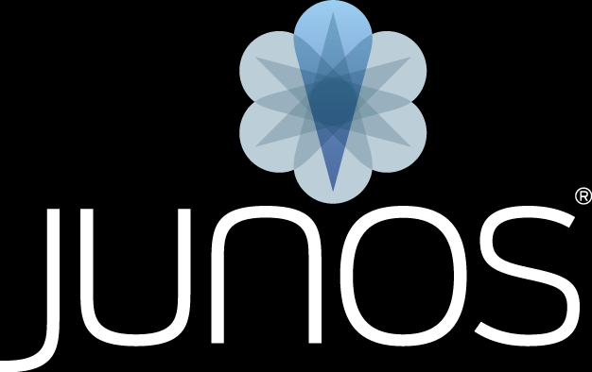

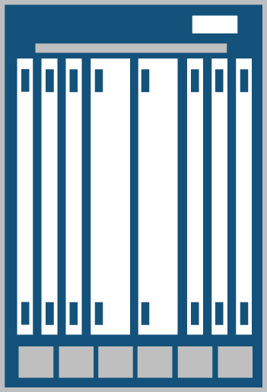
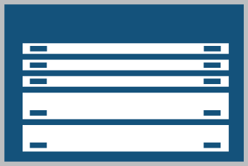
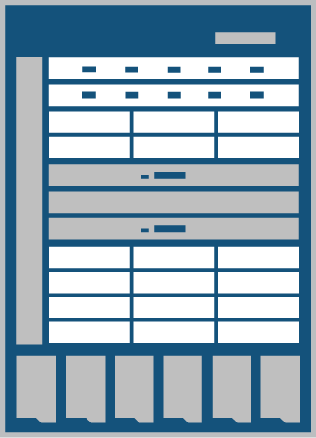
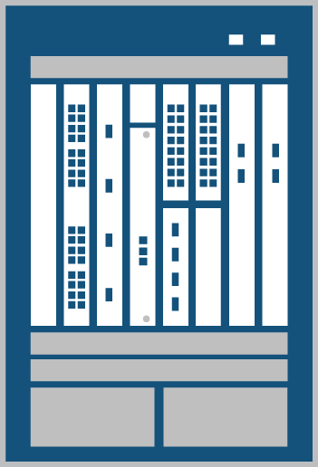
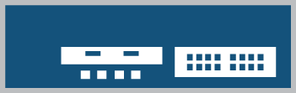


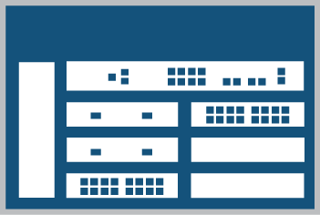

что такое FIREFLY
Виртуализированная среда
VM1
VM2
VM3
VM4
Firefly
Hypervisor
Устройства SRX’s & Junos
Juniper представляет лучшее в отрасли решение с Junos OS и функциями МЭ SRX в виде ПО для развертывания в витуальных средах
Notes:
This slide is a build

Slide 18
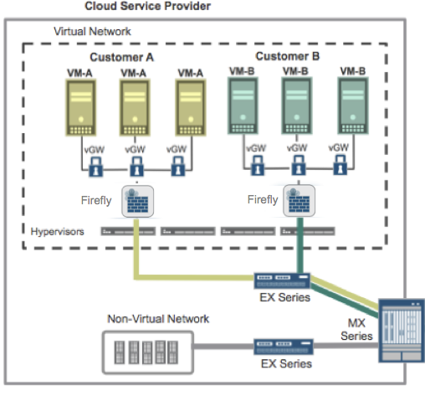

Безграничные возможности – (1,2,3)
  Устройства по требованию
  Облачный сервис с простым усправлением
  Безопасность ЦОД по всему периметру
  Общая безопасность виртуальных и физических сетей
1
2
  Полная защита начиная с VM (vGW) и виртуального периметра (Firefly) до физического периметра сети(SRX)!
SRX
3

Slide 19
Функционал FIREFLY
Функции безопасности и маршрутизации на виртуальной машине
  Junos как виртуальное устройство
  Совместим с архитектурой x86
Весь функционал безопасности и маршрутизации
Оптимизация производительности
  SMP kernel & multi-threaded
  flowd over multiple vCPUs
Поддержка функциональности гипервизора
  Пример: vMotion, snapshots, HA/FT, Cloning, Management etc.
Junos Routing Protocols and SDK
Junos Rich & Extensible Security Stack
Perimeter
Content
Application
Firewall
Anti-Virus
Application
Awareness
VPN
IPS
Full IDP Feature Set
NAT
Web Filtering
Identity
Awareness
Network Admission
Control
Anti-Spam
CLI, JWeb, SNMP, JSpace- SD, Hypervisor Mgmt, HA/FT
*Not all features available at FRS

Slide 20
JunosV Firefly – Timelines & roadmap
Q1/2013 – Controlled Availability
Roadmap
Routing
NAT
Firewall
DHCP
Функционал
UTM, IDP,
HA/Clustering,
AppSecure
KVM, HyperV, Xen Hypervisors
Junos SDK
Density, Scale, & Performance optimization
Управление
Junos Space APP + APIs roadmap
vGW and Firefly – Unified management
IaaS Management integration
OpenStack and CloudStack integration
Solution portals
Family inet
Family inet6
Static routing
BGP
OSPF
RIP
PIM
MPLS/VPLS
Source NAT
Destination NAT
Static NAT
Persistent NAT
Firewall policy
Screens
SYN cookie
DHCP client
DHCP server
DHCP relay
ALGs
VPN
DNS
FTP
H323
MGCP
MS-RPC
PPTP
RSH
RTSP
SCCP
SIP
SQL
SUN-RPC
TALK
TFTP
IKE-ESP
Policy-based
Route-based
Dynamic VPN
Manual key
Auto key
IKE phase 1
IKE phase 2
Anti-replay
XAUTH
DPD
VPN monitor
Tunnel mode
AH & ESP
des/3des/aes
Sha-1/md5
Hypervisors
Management
VMWare
CLI, JWeb, JSpace-SD, SNMP
STRM, Junos Space App + APIs

Slide 21

FIREFLY MANAGEABILITY
“Security Policy & Basic Device Management”
“Virtual Provisioning”
Junos Space – Security Design
CLI + Junos Scripts
JWeb
SNMP
STRM (Logging and Reporting), Syslog, Traceroute
Security Insight
Junos LMS
Policy Manager APIs
Junos Space LaunchPad
App for Junos Space Platform
Long term single provisioning point and systems manager for vGW and Firefly deployments
Long Term Support for popular Cloud Management tools
  vCenter, RHEV-M, SCVMM, ServerCenter
  vCloud Director, CloudStack, OpenStack
Features (Life Cycle Management):
  Provisioning
  Bootstrapping
  Troubleshooting/Debug
  Log management

Slide 22
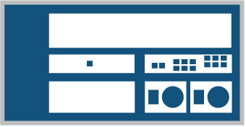
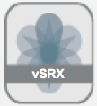
firefly Сценарий использования
Virtualized datacenter environments
Заказчик
Облачные сервис провайдеры, большие компании которые виртуализируют свои ЦОД
Цель
Максимально эффективно использовать ресурсы, расширить виртуализацию на сетевую часть
Требования
Маршрутизация и функции безопасности без использования выделенных устройств . До 2Gbps трафика.
Решение
Установить FireFly и возможно выделенную платформу по маршрутизации
Datacenter: BEFORE
Datacenter: AFTER
Virtualized Environment
Virtualized Environment
VM1
VM2
VM3
VM4
Physical Firewall
VM1
VM2
VM3
VM4
WAN
WAN

Slide 23

Где используется
Облака
Сегментация сетей заказчиков
Безопасность периметра
Bring your own VM
MSPs
Security as a Service
Облачный CPE
Service offload
Предприятия
Гибкая безопасность
Обучение
Частные облака
Функциональное разделение
Безопасность периметра
Соответствие

Slide 24
JunosV Firefly – Производительность @ FRS*
Аппаратная платформа: Dell PowerEdge R710 - Dual Socket, 8 core, 2.4 GHz, 32G RAM
Virtual CPUs | 2 vCPUs
Virtual Memory | 1 GB vRAM
Virtual NICs | 4 vNICs
Max Address book | 128
Max Address set/zone | 128
Max Policies | 512
Max Policies with Count | 128
Static NAT pools | 256
MAC/ARP table size | 1K
Max Firewall Sessions | 64K
Route Based IPSec VPN | 512
Tunnel Setup Rate Route-based VPN | 5
IPsec VPN - 3DES-SHA1 (1400B pkts) or AES256-SHA1 | 200 Mbps
IPsec VPN - 3DES-SHA1 (IMIX-pkt sizes) or AES256-SHA1 | 100 Mbps
IPsec VPN - 3DES-SHA1 (64B Pkts) or AES256-SHA1 | 50k PPS
Firewall (IMIX pkt sizes) | 1Gbps
Firewall (1518B pkts) | 2Gbps
Firewall Ramp Rate (TCP) | 9K CPS
Firewall Ramp Rate with Logging (TCP) | 8K CPS
Firewall Latency (64) | 80 uS
NAT (64B pkts) | 200K PPS
NAT (IMIX pkt sizes) | 600 Mbps
NAT (1518B pkts) | 1.8 Gbps
Max Zones | 32
Max VLANs | 4K
*Performance function of underlying HW and amount of resources allocated to Firefly instance.

Slide 25
Juniper AND Threatstop
Let’s do security together
Notes:
Thank you for taking time to learn more about Mykonos solution from Juniper Networks. Mykonos is the the first and only “intrusion deception” system in the marketplace.
I’m going to spend 20 minutes helping you understand how Mykonos thinks about and manages hackers and web security.
Before we get started I would like to better understand what prompted your interest in Mykonos and how your organization thinks about and manages hackers. It would very helpful to me if you could describe the types of attacks that concern you and the web app security products you use to defend against those attacks. And finally, any guidance you can provide me about your timeline for taking action to better secure your web apps would help me better support you.
(Thank you for sharing – that was very helpful.)
Let me provide you with some background on Mykonos.
Mykonos was spun-off from BlueTie, a large SaaS provider that utilized a variety of off-the-shelf and custom web apps to process terabytes of information for millions of users.
So, naturally, the web apps had vulnerabilities. And hackers exploited those vulnerabilities causing much damage. So we responded. We went out into the marketplace and found the same two products – code scanning and WAFs – that are available to every other organization.
Now, the challenges and problems with code scanning are very clear: scanning code for vulnerabilities yields thousands of lines of data with a false positive rate that can approach 50%. Employing an army of analysts to sift through that data and make sense of it is not practical. And when you discover an off-the-shelf vulnerability, perhaps in Share Point, how do you fix it? You are at the mercy of the vendor. You can’t exactly ring up Microsoft and ask them to fix it. Code scanning does not provide real time security.
The other option is a WAF. Ironically, WAFs are not firewalls. Think about a network firewall – it’s a positive security model (white list) which means it blocks ALL traffic except for a known set of friendly traffic. A WAF is the exact opposite of a network firewall. It is a negative security model (black list) which means it allows ALL traffic except for a known set of bad traffic – or what is commonly referred to a library of attack signatures.
WAFs rely exclusively on the failed anti-virus approach. Every year antivirus amasses a bigger library of signatures, and every year anti-virus fails to solve the malware problem. In fact, today, I can purchase a single custom virus that won’t match any existing AV signature.” It’s worth mentioning that the average AV program has 40 million signatures. Do we really believe the 41st millionth signature will solve the problem? We don’t. So, the very product (WAF) that has defined web security for the last 7 or 8 years isn’t even what it claims to be.
More to the point, a finite library of attack signatures can stop and infinite number of attacks.
Additionally, we learned that it is very difficult to deploy WAFs in block mode. The reason: signatures. For example, if you write a rigid signature it blocks too much traffic, yielding false positives. If you write a flimsy signature it allows too much traffic, creating vulnerabilities. So what are you left with? A WAF that can’t run in block mode is nothing more than a fancy log file - or an IDS – that gives you a picture of your business after it burned down. What we wanted - and what every organization needs - is a smoke alarm that detects suspicious or malicious activity without false positives before that activity materializes into an attack. Mykonos is not only your smoke alarm – it is you fire engine too!

Slide 26

МЫ ЗНАЕМ, ГДЕ ЧЕРВИ
И С КЕМ ОНИ
ГОВОРЯТ

Slide 27
Тяжелая правда
95% организаций заражены
4-10% от всего трафика генерируются
малваре
Notes:
Source Gartner:
"There is widespread agreement that advanced attacks are bypassing our traditional signature-based security controls and persisting undetected on our systems for extended periods of time. The threat is real. You are compromised; you just don’t know it.”
As of today there are 4,881,631 active bad IPs , it is hard to assume that you or others are part of the 5%, and truthfully there is only one way to find out. We can show you, as you will find out in a bit.

Slide 28
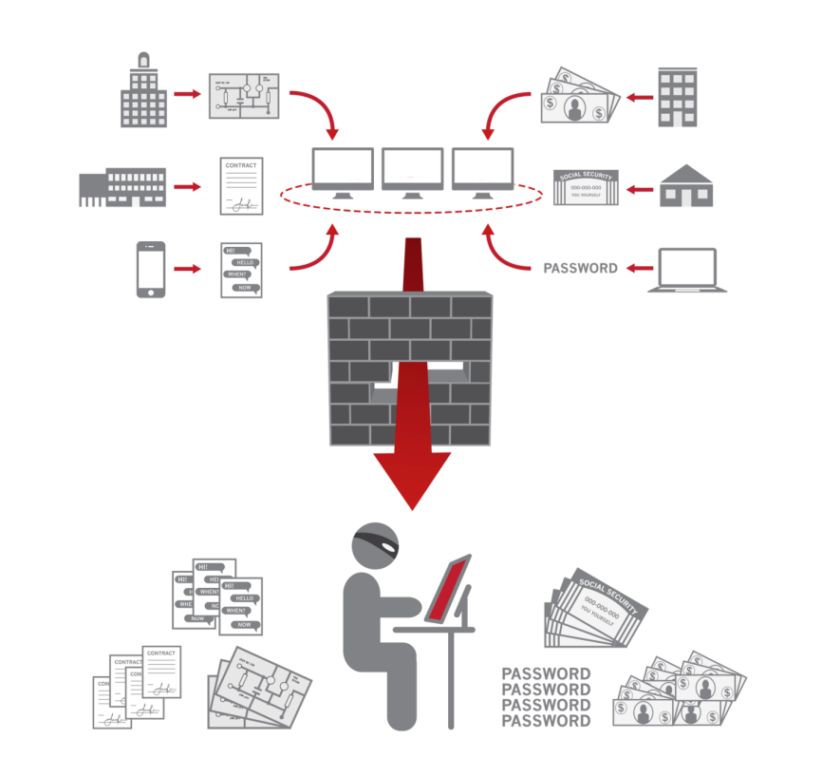
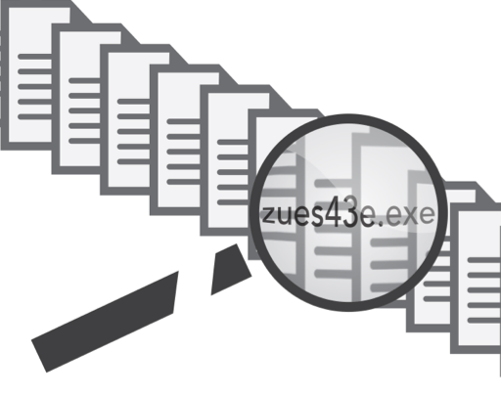
Зачем был создан
Вы можете понять этот трафик легитимный?
  Например SSL пакеты не проверяются
Мобильные устройства?
  98% мобильных устройств не защищены
  80% мобильных устройств имеют доступ к корпоративной сети
Почему традиционные средства защиты не работают?
  Фокус на сигнатурах
  Нет обратной связи
  Злоумышленник зная тип вашей защиты может ее обойти
28

Slide 29

Наш большой РУТ
Paul Mockapetris
Архитектор
DNS
Notes:
Source Gartner:
"There is widespread agreement that advanced attacks are bypassing our traditional signature-based security controls and persisting undetected on our systems for extended periods of time. The threat is real. You are compromised; you just don’t know it.”
As of today there are 4,881,631 active bad IPs , it is hard to assume that you or others are part of the 5%, and truthfully there is only one way to find out. We can show you, as you will find out in a bit.

Slide 30
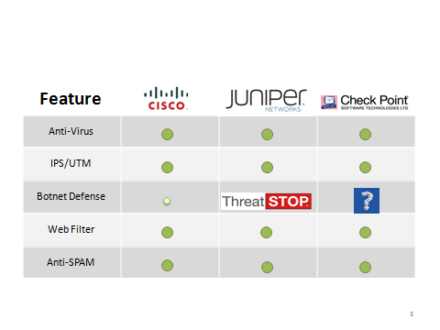
Поддержка вендоров
30

Slide 31
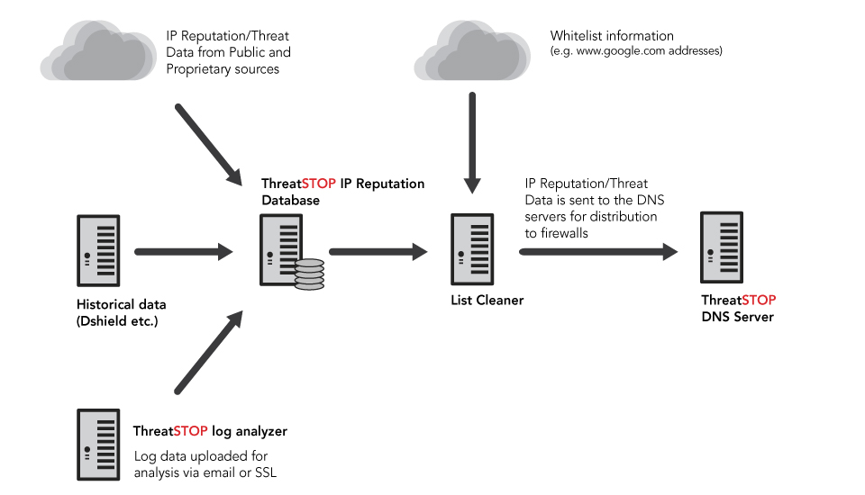
Как работает
Notes:
31
Deep relationships & trust with malware
Researchers: Dshield, Malware Threat Center, Shadowserver, SIE, etc. (should have the complete list from Francis in our pocket)
More than 30 feeds
24 million IPs in DB (think tom wanted you to change this?
10 million + customer
loglines per day
Constantly monitoring
quality & culling sources
Key variables:
# of reporting sources
Age
Frequency of bad behavior
Last seen
Predictive, actionable threat list every 15 minutes
Extreme care taken to remove false positives
New bad IP addresses identified and distributed faster than competitors
1-4 hours depending on source – others >24 hours
Complete list ~35,000 entries (~25,000 IPs + 10,000 subnets)
Also Geoblock feeds and Tor Exit Nodes (~3000)

Slide 32
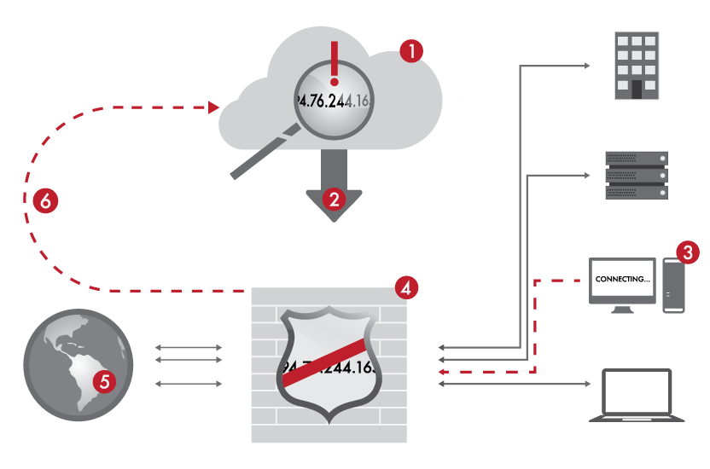
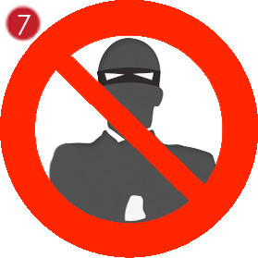
Как работает
Enables firewalls to block all traffic to and from known criminal sites
ThreatSTOP выставляет репутационный статус IP
Фаервол загружает правила
Зараженный хост пытается связаться с хозяином, сделать “звонок домой”
Звонок домой заблокирован
Вы не видимы снаружи
Фаервол отсылает репорт
Еще один злодей остановлен
32

Slide 33
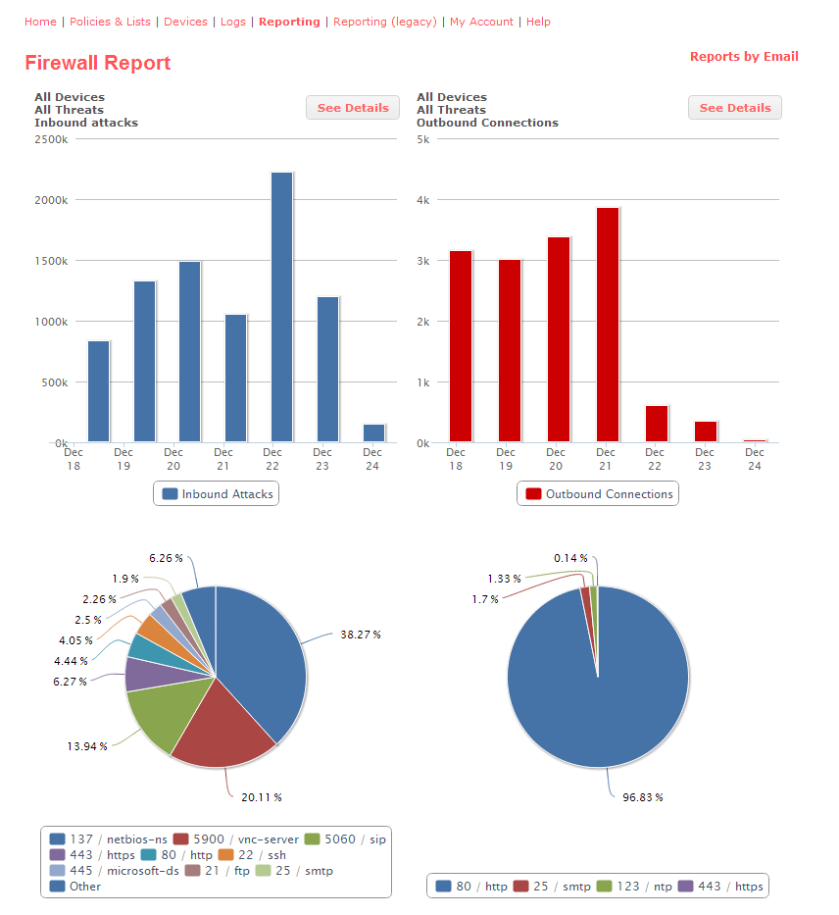
Отчет
33

Slide 34
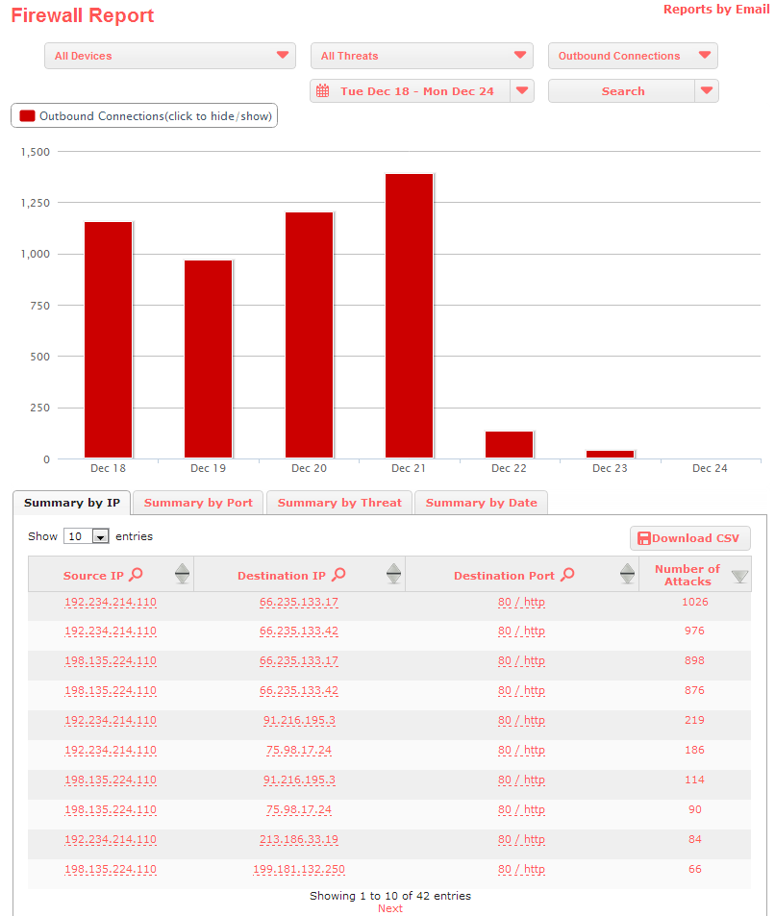
Отчет
34

Slide 35
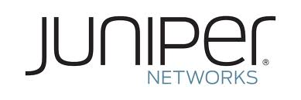

Как использовать
MX
SRX
35

Slide 36
ROADMAP
Выполнение ФЗ-139 !!!!
DNS RPZ

Slide 37









Наши клиенты
Они доверяют нам

Slide 38
Stop Worms!
Артур Леонов,
Regional Director, Russia and CIS
aleonov@threatstop.com
812.983.98.47
Notes:
38
38

Slide 39
Notes:
39
Mykonos не панацея от всех проблем, эффективен при использовании совместно с другими продуктами безопаности, тем менее один из самых эффективных средств анализа атак.

Slide 40
System Scale
EX8200 vs. EX9200 Core
Scale | EX9200 | EX8200
Layer 2
# of LAGs | 480 | 255
Ports/LAG | 16 (64) | 12
# of native analyzer sessions | 64 | 1
# of destination ports/vlans per analyzer | 8
VLANs (Bridge Domains) | 32K | 4K
MAC table size | 1M | 160K
MAC accounting entries | 1M | -
Layer 3
RIB IPv4 capacity | 1M | 3.2M
RIP IPv6 capacity | 1M | 3.2M
IPv4 unicast routes (FIB) | 256K (shared) | 1M
IPv6 unicast routes (FIB) | 256K (shared) | 1M
ARP entries | 256K | 128K
Multicast
IPv4 multicast routes (FIB) | 256K (shared) | 200K
IPv6 multicast routes (FIB) | 256K (shared) | 200K
Multicast groups | 256k | 26K
IGMP snooping entries | 100K
Misc.
GRE tunnels | 32K | 256
Security and Qos ACLs | 256K | 54K
Per queue buffers | 100ms | 512MB
Policers | 16K | 2K
High logical scale for Layer 2, multicast and multi-tenancy

